Slide 1
Legacy Systems

Slide 2
Input-process-output
Input components read and validate data from a terminal or file
Processing components carry out some transformations on that data
Output components format and print the results of the computation
Input, process and output can all be represented as functions with data ‘flowing’ between them

Slide 3
Functional design process
Data-flow design
  Model the data processing in the system using data-flow diagrams
Structural decomposition
  Model how functions are decomposed to sub-functions using graphical structure charts that reflect the input/process/output structure
Detailed design
  The functions in the design and their interfaces are described in detail.

Slide 4
Data flow diagrams
Show how an input data item is functionally
transformed by a system into an output data
item
Are an integral part of many design methods
and are supported by many CASE systems
May be translated into either a sequential or
parallel design. In a sequential design,
processing elements are functions or
procedures; in a parallel design, processing
elements are tasks or processes

Slide 5
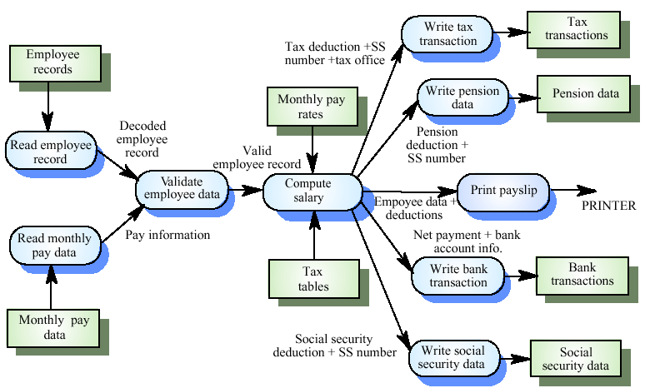
Payroll system DFD

Slide 6
Payroll batch processing
The functions on the left of the DFD are input functions
  Read employee record, Read monthly pay data, Validate employee data
The central function - Compute salary - carries out the processing
The functions to the right are output functions
  Write tax transaction, Write pension data, Print payslip, Write bank transaction, Write social security data

Slide 7
Transaction processing
A ban ATM system is an example of a transaction processing system
Transactions are stateless in that they do not rely on the result of previous transactions. Therefore, a functional approach is a natural way to implement transaction processing

Slide 8
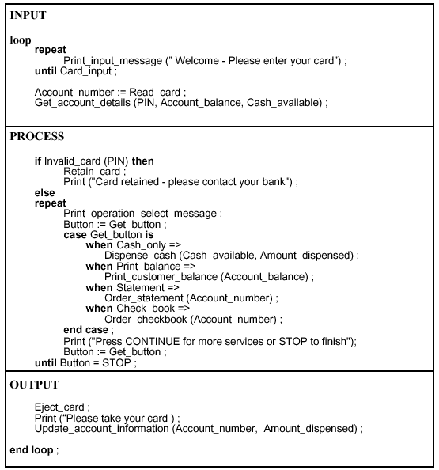
Design description of an ATM

Slide 9
Using function-oriented design
For some classes of system, such as some transaction processing systems, a function-oriented approach may be a better approach to design than an object-oriented approach
Companies may have invested in CASE tools and methods for function-oriented design and may not wish to incur the costs and risks of moving to an object-oriented approach

Slide 10
Legacy system assessment
Organisations that rely on legacy systems must choose a strategy for evolving these systems
  Scrap the system completely and modify business processes so that it is no longer required
  Continue maintaining the system
  Transform the system by re-engineering to improve its maintainability
  Replace the system with a new system
The strategy chosen should depend on the system quality and its business value

Slide 11
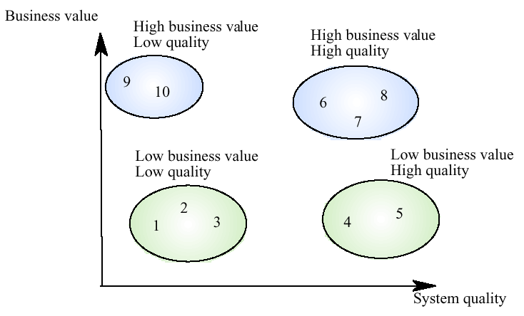
System quality and business value

Slide 12
Legacy system categories
Low quality, low business value
  These systems should be scrapped
Low-quality, high-business value
  These make an important business contribution but are expensive to maintain. Should be re-engineered or replaced if a suitable system is available
High-quality, low-business value
  Replace with COTS, scrap completely or maintain
High-quality, high business value
  Continue in operation using normal system maintenance

Slide 13
Business value assessment
Assessment should take different viewpoints into account
  System end-users
  Business customers
  Line managers
  IT managers
  Senior managers
Interview different stakeholders and collate results

Slide 14
System quality assessment
Business process assessment
  How well does the business process support the current goals of the business?
Environment assessment
  How effective is the system’s environment and how expensive is it to maintain
Application assessment
  What is the quality of the application software system

Slide 15
Business process assessment
Use a viewpoint-oriented approach and seek answers from system stakeholders
  Is there a defined process model and is it followed?
  Do different parts of the organisation use different processes for the same function?
  How has the process been adapted?
  What are the relationships with other business processes and are these necessary?
  Is the process effectively supported by the legacy application software?

Slide 16
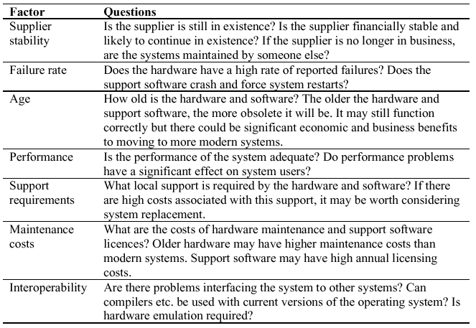
Environment assessment

Slide 17
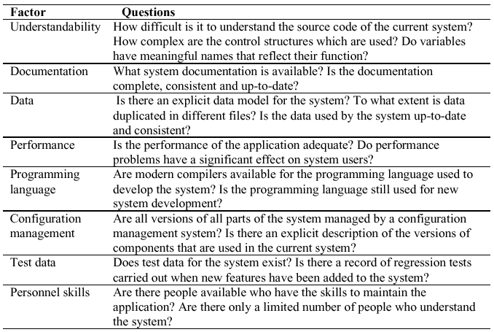
Application assessment

Slide 18
System measurement
You may collect quantitative data to make an assessment of the quality of the application system
  The number of system change requests
  The number of different user interfaces used by the system
  The volume of data used by the system

